Slide 1

First-Order Logic in Artificial intelligence
In the topic of Propositional logic, we have seen that how to represent statements using propositional logic. But unfortunately, in propositional logic, we can only represent the facts, which are either true or false. Propositional logic is not sufficient to represent the complex sentences or natural language statements. The propositional logic has very limited expressive power. Consider the following sentence, which we cannot represent using propositional logic.
"Some humans are intelligent“.
To represent the above statements, PL logic is not sufficient, so we required some more powerful logic, such as first-order logic.
Alka Singh AI Unit 03

Slide 2
Continue…
First-Order logic:
First-order logic is another way of knowledge representation in artificial intelligence. It is an extension to propositional logic.
FOL is sufficiently expressive to represent the natural language statements in a concise way.
First-order logic is also known as Predicate logic or First-order predicate logic. First-order logic is a powerful language that develops information about the objects in a more easy way and can also express the relationship between those objects.
First-order logic (like natural language) does not only assume that the world contains facts like propositional logic but also assumes the following things in the world:
Alka Singh AI Unit 03

Slide 3
Continue…
  -- Objects: A, B, people, numbers, colors, wars, theories, squares etc.
  Relations: It can be unary relation such as: red, round, is adjacent, or n-any relation such as: the sister of, brother of, has color, comes between
  Function: Father of, best friend, third inning of, end of, ......
As a natural language, first-order logic also has two main parts:
  Syntax
  Semantics
Alka Singh AI Unit 03

Slide 4
Continue…
Syntax of First-Order logic:
The syntax of FOL determines which collection of symbols is a logical expression in first-order logic. The basic syntactic elements of first-order logic are symbols. We write statements in short-hand notation in FOL.
Basic Elements of First-order logic:
Following are the basic elements of FOL syntax:
Alka Singh AI Unit 03

Slide 5
Continue…
Constant
1, 2, A, John, Mumbai, cat,....
Variables
x, y, z, a, b,....
Predicates
Brother, Father, >,....
Function
sqrt, LeftLegOf, ....
Connectives
∧, ∨, ¬, ⇒, ⇔
Equality ==
Quantifier ∀, ∃
Alka Singh AI Unit 03

Slide 6
Continue…
Atomic sentences:
Atomic sentences are the most basic sentences of first-order logic. These sentences are formed from a predicate symbol followed by a parenthesis with a sequence of terms.
We can represent atomic sentences as Predicate (term1, term2, ......, term n).
Example: Ravi and Ajay are brothers: => Brothers(Ravi, Ajay).
Chinky is a cat: => cat (Chinky).
Alka Singh AI Unit 03

Slide 7
Continue…
Complex Sentences:
Complex sentences are made by combining atomic sentences using connectives.
King (Richard) v King(John)
~ King (Richard) => King (John)
Alka Singh AI Unit 03

Slide 8
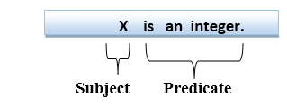
Continue…
First-order logic statements can be divided into two parts:
Subject: Subject is the main part of the statement.
Predicate: A predicate can be defined as a relation, which binds two atoms together in a statement.
Consider the statement: "x is an integer.", it consists of two parts, the first part x is the subject of the statement and second part "is an integer," is known as a predicate.

Slide 9
Continue…
Quantifiers in First-order logic:
A quantifier is a language element which generates quantification, and quantification specifies the quantity of specimen in the universe of discourse.
These are the symbols that permit to determine or identify the range and scope of the variable in the logical expression. There are two types of quantifier:
  Universal Quantifier, (for all, everyone, everything)
  Existential quantifier, (for some, at least one).
Alka Singh AI Unit 03

Slide 10
Continue…
Universal Quantifier:
Universal quantifier is a symbol of logical representation, which specifies that the statement within its range is true for everything or every instance of a particular thing.
The Universal quantifier is represented by a symbol ∀, which resembles an inverted A.
Note: In universal quantifier we use implication "→".
If x is a variable, then ∀x is read as:
For all x
For each x
For every x
Alka Singh AI Unit 03

Slide 11
Continue…
Example: All man drink coffee.
Let a variable x which refers to a man so all x can be represented as below:
∀x man(x) → drink (x, coffee).
It will be read as: There are all x where x is a man who drink coffee.
Alka Singh AI Unit 03

Slide 12
Continue…
Existential Quantifier:
Existential quantifiers are the type of quantifiers, which express that the statement within its scope is true for at least one instance of something.
It is denoted by the logical operator ∃, which resembles as inverted E. When it is used with a predicate variable then it is called as an existential quantifier.
Note: In Existential quantifier we always use AND or Conjunction symbol (∧).
If x is a variable, then existential quantifier will be ∃x or ∃(x). And it will be read as:
There exists a 'x.'
For some 'x.‘
For at least one 'x.'
Alka Singh AI Unit 03

Slide 13
Continue…
Example: Some boys are intelligent.
∃x: boys(x) ∧ intelligent(x)
It will be read as: There are some x where x is a boy who is intelligent
Alka Singh AI Unit 03

Slide 14
Continue…
Points to remember:
The main connective for universal quantifier ∀ is implication →.
The main connective for existential quantifier ∃ is and ∧.
Properties of Quantifiers:
In universal quantifier, ∀x∀y is similar to ∀y∀x.
In Existential quantifier, ∃x∃y is similar to ∃y∃x.
∃x∀y is not similar to ∀y∃x.
Alka Singh AI Unit 03

Slide 15
Continue…
Some Examples of FOL using quantifier
1. All birds fly.
In this question the predicate is "fly(bird)."
And since there are all birds who fly so it will be represented as follows.
∀x bird(x) →fly(x).
2. Every man respects his parent.
In this question, the predicate is "respect(x, y)," where x=man, and y= parent.
Since there is every man so will use ∀, and it will be represented as follows:
∀x man(x) → respects (x, parent).
Alka Singh AI Unit 03

Slide 16
Continue…
3. Some boys play cricket.
In this question, the predicate is "play(x, y)," where x= boys, and y= cricket. Since there are some boys so we will use ∃, and it will be represented as:
∃x : boys(x) ꓥ play(cricket).
4. Not all students like both Mathematics and Science.
In this question, the predicate is "like(x, y)," where x= student, and y= subject.
Since there are not all students, so we will use ∀ with negation, so following representation for this:
¬∀ (x) [ student(x) → like(x, Mathematics) ∧ like(x, Science)].
Alka Singh AI Unit 03

Slide 17
Continue…
Free and Bound Variables:
There are two types of variables in First-order logic which are given below:
Free Variable: A variable is said to be a free variable in a formula if it occurs outside the scope of the quantifier.
Example: ∀x ∃(y)[P (x, y, z)], where z is a free variable.
Bound Variable: A variable is said to be a bound variable in a formula if it occurs within the scope of the quantifier.
Example: ∀x ∃(y)[P (x, y, z)], where x and y are a bound variable.
Alka Singh AI Unit 03

Slide 18
Continue…
Inference in First-Order Logic
Inference in First-Order Logic is used to deduce new facts or sentences from existing sentences. Before understanding the FOL inference rule, let's understand some basic terminologies used in FOL.
Substitution:
Substitution is a fundamental operation performed on terms and formulas. It occurs in all inference systems in first-order logic. The substitution is complex in the presence of quantifiers in FOL. If we write F[a/x], so it refers to substitute a constant "a" in place of variable "x".
Note: First-order logic is capable of expressing facts about some or all objects in the universe.
Alka Singh AI Unit 03

Slide 19
Continue…
Equality:
First-Order logic does not only use predicate and terms for making atomic sentences but also uses another way, which is equality in FOL. For this, we can use equality symbols which specify that the two terms refer to the same object.
Example: Brother (John) = Smith.
As in the above example, the object referred by the Brother (John) is similar to the object referred by Smith. The equality symbol can also be used with negation to represent that two terms are not the same objects.
Example: ￢(x=y) which is equivalent to x ≠y.
Alka Singh AI Unit 03

Slide 20
Continue…
FOL inference rules for quantifier:
As propositional logic we also have inference rules in first-order logic, so following are some basic inference rules in FOL:
Universal Generalization
Universal Instantiation
Existential Instantiation
Existential introduction
Alka Singh AI Unit 03

Slide 21

Continue…
1. Universal Generalization:
Universal generalization is a valid inference rule which states that if premise P(c) is true for any arbitrary element c in the universe of discourse, then we can have a conclusion as ∀ x P(x).
It can be represented as:
This rule can be used if we want to show that every element has a similar property.
In this rule, x must not appear as a free variable.
Example: Let's represent, P(c): "A byte contains 8 bits", so for ∀ x P(x) "All bytes contain 8 bits.", it will also be true.
Alka Singh AI Unit 03

Slide 22

Continue…
2. Universal Instantiation:
Universal instantiation is also called as universal elimination or UI is a valid inference rule. It can be applied multiple times to add new sentences.
The new KB is logically equivalent to the previous KB.
As per UI, we can infer any sentence obtained by substituting a ground term for the variable.
The UI rule state that we can infer any sentence P(c) by substituting a ground term c (a constant within domain x) from ∀ x P(x) for any object in the universe of discourse.
It can be represented as:
Example:1.
IF "Every person like ice-cream"=> ∀x P(x) so we can infer that
"John likes ice-cream" => P(c)

Slide 23
Continue…
Example: 2.
Let's take a famous example,
"All kings who are greedy are Evil." So let our knowledge base contains this detail as in the form of FOL:
∀x king(x) ∧ greedy (x) → Evil (x),
So from this information, we can infer any of the following statements using Universal Instantiation:
King(John) ∧ Greedy (John) → Evil (John),
King(Richard) ∧ Greedy (Richard) → Evil (Richard),
King(Father(John)) ∧ Greedy (Father(John)) → Evil (Father(John)),
Alka Singh AI Unit 03

Slide 24
Continue…
3. Existential Instantiation:
Existential instantiation is also called as Existential Elimination, which is a valid inference rule in first-order logic.
It can be applied only once to replace the existential sentence.
This rule states that one can infer P(c) from the formula given in the form of ∃x P(x) for a new constant symbol c. ∃x P(x)
        P(c)
The restriction with this rule is that c used in the rule must be a new term for which P(c ) is true.
It can be represented as:
Example:
From the given sentence: ∃x Crown(x) ∧ OnHead(x, John),
Alka Singh AI Unit 03

Slide 25
Continue…
So we can infer: Crown(K) ∧ OnHead( K, John), as long as K does not appear in the knowledge base.
The above used K is a constant symbol, which is called Skolem constant.
The Existential instantiation is a special case of Skolemization process.
Alka Singh AI Unit 03

Slide 26

Continue…
4. Existential introduction
An existential introduction is also known as an existential generalization, which is a valid inference rule in first-order logic.
This rule states that if there is some element c in the universe of discourse which has a property P, then we can infer that there exists something in the universe which has the property P.
It can be represented as:
Example: Let's say that,
"Priyanka got good marks in English."
"Therefore, someone got good marks in English."
Alka Singh AI Unit 03

Slide 27
Prenex Normal Form
A closed formula α of FOL is said to be in Prenex Normal Form(PNF) if and only if α is represented as (q1 x1)(q2 x2)……(qn xn)(M), where, qk, (1 ≤ k ≤ n) is either ∀ or Ǝ quantifier and M is a formula free from quantifiers.
A list of quantifiers (q1 x1)(q2 x2)……(qn xn) is called prefix and M is called the matrix of a formula α.

Slide 28
Prenex Normal Form
Example
(Ǝx)(P(x) v Q(x)) and (∀x)(Ǝy)(P(x) ꓥ Q(x,y)) are in PN form.
(∀x) (P(x) → (Ǝy) Q(x,y)) is not in PN form.

Slide 29
Transformation of Formula into PNF
α[x] – a formula α, which contains a variable x.
α – a formula without a variable x.
q – Quantifiers (∀ or Ǝ)

Slide 30
Transformation of Formula into PNF
Equivalence Laws: There are following pairs of logically equivalent formulae called equivalence laws in addition to the equivalence laws given for propositional logic.
(q x) α [x] v β = (q x) (α [x] v β )
α v q(x) v β[x] = q(x) (α v β[x] )
(q x) α [x] ꓥ β = (q x) (α [x] ꓥ β )

Slide 31
Transformation of Formula into PNF
4. α ꓥ q(x) β[x] = q(x) (α ꓥ β[x] )
5. ~((∀x) α [x]) = (Ǝx) (~α[x])
6. ~((Ǝx) α[x]) = (∀x) (~α [x])
7. (∀x) α [x] ꓥ (∀x) β[x] = (∀x)(α [x] ꓥ β[x])
8. (Ǝx) α[x] v (Ǝx) β[x] = (Ǝx) (α[x] v β[x])

Slide 32
Transformation of Formula into PNF
Quantifiers ∀ and Ǝ can distribute over ꓥ and V respectively but cannot distribute over V and ꓥ respectively, i.e,
1. (∀x) α [x] v (∀x) β[x] ≠ (∀x)(α [x] v β[x])
2. (Ǝx) α[x] ꓥ (Ǝx) β[x] ≠ (Ǝx) (α[x] ꓥ β[x])

Slide 33
Renaming Bound Variables
For the cases mentioned in previous slide we have to do something special. Every bound variable x in β[x] can be renamed by y such that y does not occur in α and β. Then
1. (∀x) α [x] v (∀x) β[x] = (∀x)(α [x] v (∀y) β[y]) where y does not occur in α and β.
= (∀x) (∀y)(α [x] v β[y])

Slide 34
Renaming Bound Variables
Thus by remaining all occurrence of x by y in a formula we get two more equivalence law.
9. (∀x) α [x] v (∀x) β[x] = (∀x)(∀y)(α [x] v β[y])
10. (Ǝx) α[x] ꓥ (Ǝx) β[x] = (Ǝx)(Ǝy)(α[x] ꓥ β[y])
These equivalence laws are used for transforming a formula into PNF.

Slide 35
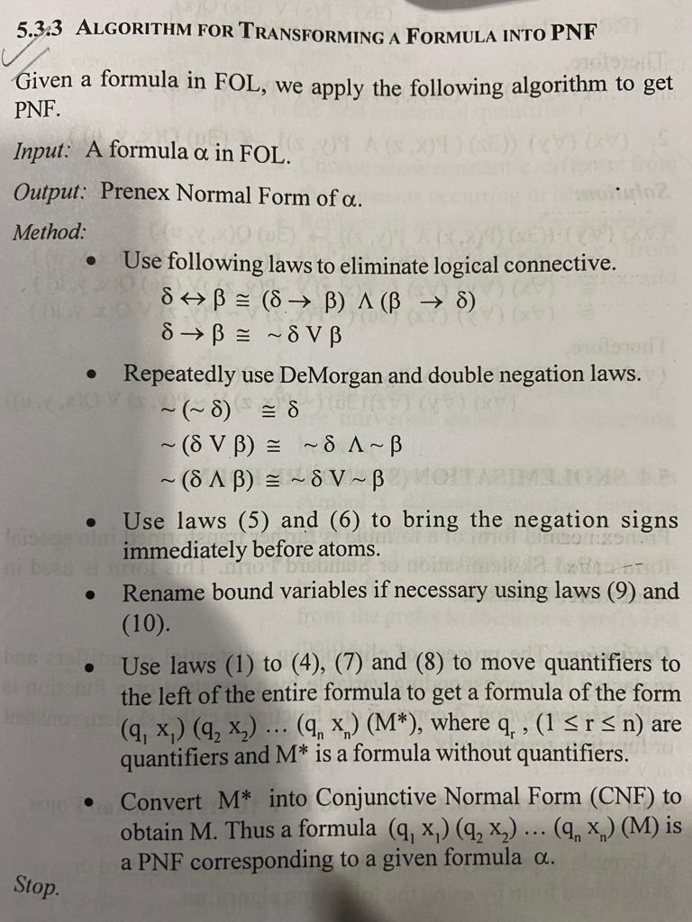
Algorithm for Transforming a formula into PNF

Slide 36
Example
Transform the following formulae into its equivalent PNF representation.
1. (∀x) P(x) → (Ǝx)Q(x)
Sol. (∀x) P(x) → (Ǝx)Q(x) = ~ (∀x)P(x) v (Ǝx)Q(x)
= (Ǝx)~P(x) v (Ǝx)Q(x)
= (Ǝx)(~P(x) v Q(x))

Slide 37
Example
2. (∀x)(∀y) (Ǝz)(P(x,z) ꓥ P(y,z)) → (Ǝu)Q(x,y,u)
Sol.
(∀x)(∀y) (Ǝz)(P(x,z) ꓥ P(y,z)) → (Ǝu)Q(x,y,u)
= (∀x)(∀y)(~(Ǝz)(P(x,z) ꓥ P(y,z)) v (Ǝu)Q(x,y,u))
= (∀x)(∀y)(∀z)(~P(x,z) v ~P(y,z)) v (Ǝu)Q(x,y,u))
= (∀x)(∀y)(∀z) (Ǝu)(~P(x,z) v ~P(y,z)) v Q(x,y,u))

Slide 38
Skolemisation (Standard Form)
The process of eliminating existential quantifiers and replacing the corresponding variable by a constant or a function is called skolemisation.
A constant or a function is called skolem constant or function, respectively.

Slide 39
Example
Obtain standard forms of the following PNF formulae.
(Ǝz)P(x) = P(c) where c is constant.
(∀x) (Ǝy) Mother(x,y)
Remove (Ǝy) from the prefix by replacing y with f(x), where ‘f’ is a skolem function that maps each individual to its mother.
Therefore, (∀x) Mother(x, f(x))

Slide 40
Example
3. (Ǝx)(∀y)(∀z)(Ǝu)(~P(x,z) ꓥ~P(y,z) ꓥ Q(x,y,u))
Sol.
(Ǝx)(∀y)(∀z)(Ǝu)(~P(x,z) ꓥ~P(y,z) ꓥ Q(x,y,u))
= (∀y)(∀z)(Ǝu)(~P(c,z) ꓥ~P(y,z) ꓥ Q(c,y,u)) where c is constant.
= (∀y)(∀z)(~P(c,z) ꓥ~P(y,z) ꓥ Q(c,y,f(y,z)) )
where u = f(y,z), f is a skolem function
So, the standard form is
(∀y)(∀z)(~P(c,z) ꓥ~P(y,z) ꓥ Q(c,y,f(y,z)) )

Slide 41
Skolemisation (Standard Form)
Hence any formula α in FOL, can be transformed into its standard form by first transforming it into PNF and then converting it into a standard form.

Slide 42
Semantic Tableaux in Predicate Logic
Tableaux is a binary tree with formula as a root and is constructed using semantic rules stated in coming slides.
A path in a tableaux is contradictory or closed if some formula α and ~ α appear on the same path.

Slide 43
Semantic Tableaux in Predicate Logic
If all the paths of a tableau are closed, then it is called a contradictory tableaux.
If tableaux with α as a root is a contradictory tableaux, then α is said to be inconsistent otherwise α is said to be consistent.

Slide 44
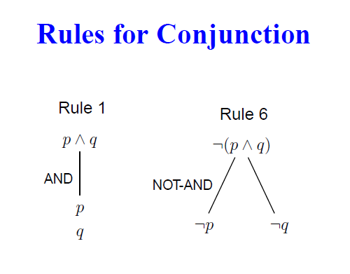
Semantic Tableaux Validity Rules

Slide 45
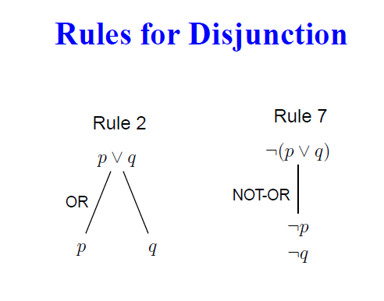
Semantic Tableaux Validity Rules

Slide 46
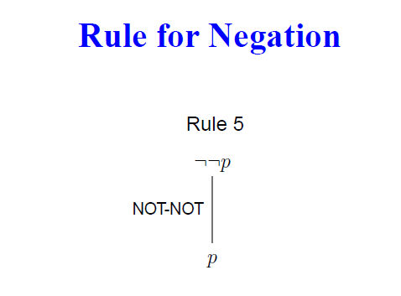
Semantic Tableaux Validity Rules
Alka Singh AI Unit 03

Slide 47
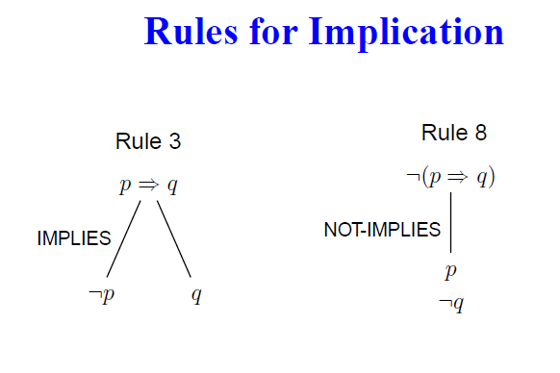
Semantic Tableaux Validity Rules
Alka Singh AI Unit 03

Slide 48
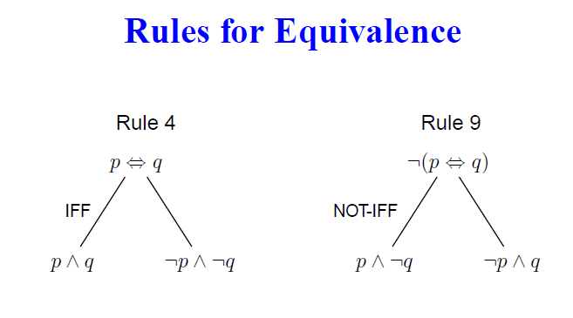
Semantic Tableaux Validity Rules
Alka Singh AI Unit 03

Slide 49
Universal Instantiation & Existential Instantiation
Rule 10: (∀x)α[x]
α[t]
Rule 11: ~{(∀x)α[x]}
~ α[c]
Rule 11a: Consider A[x,t] to be an atomic formula with x as variable and t an any ground term.

Slide 50
Universal Instantiation & Existential Instantiation
~ (∀x) A[x,t]
~ A[f(t),t] where f is some function of t
Rule 12a: Consider A[x,t] to be an atomic formula with x as variable and t an any ground term.
(Ǝx) A[x,t]
A[g(t),t] where g is some function of t

Slide 51
Universal Instantiation & Existential Instantiation
Rule 12: (Ǝx) α [x]
α [c] for any new constant c
Rule 13: ~{(Ǝx) α [x]}
~ α [t] for any ground term t

Slide 52
Example
Show that the following formulae are inconsistent.
(∀x) (P(x) ꓥ ~(Q(x) → P(x))
(∀x) (P(x) v (Q(x) < -- > ~P(x) ꓥ ~(Q(x))

Slide 53
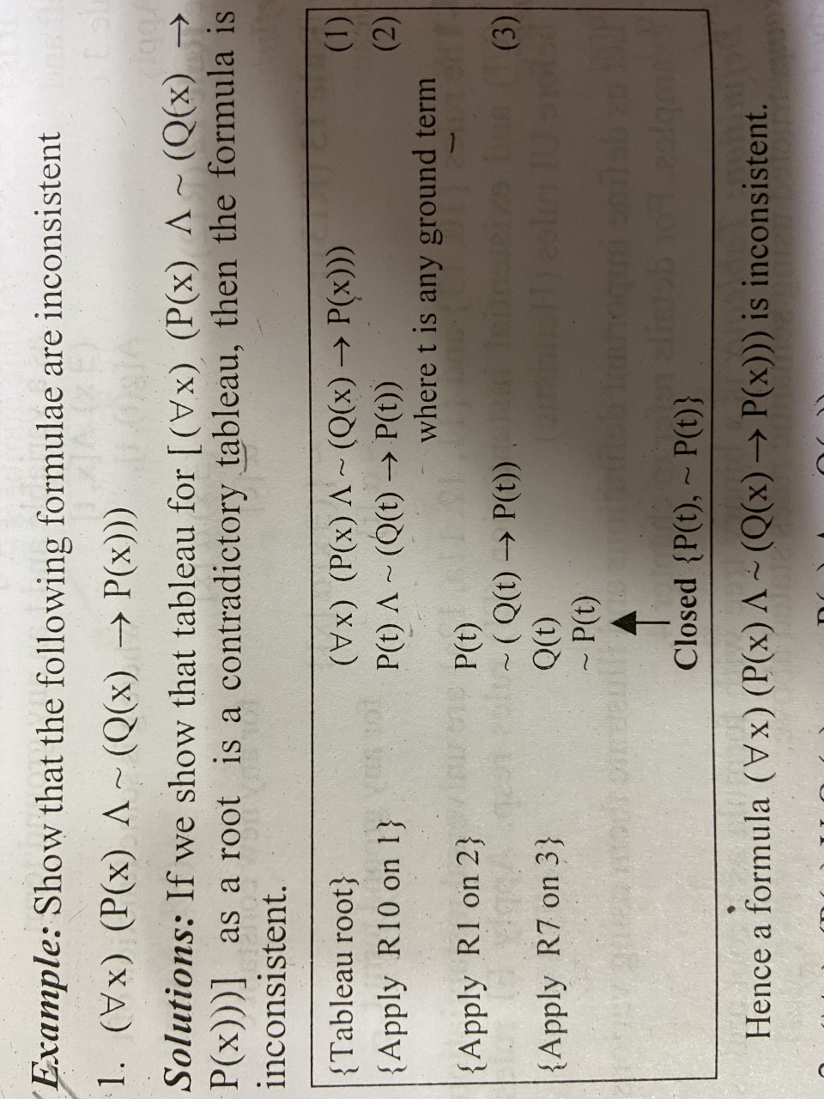
Example

Slide 54
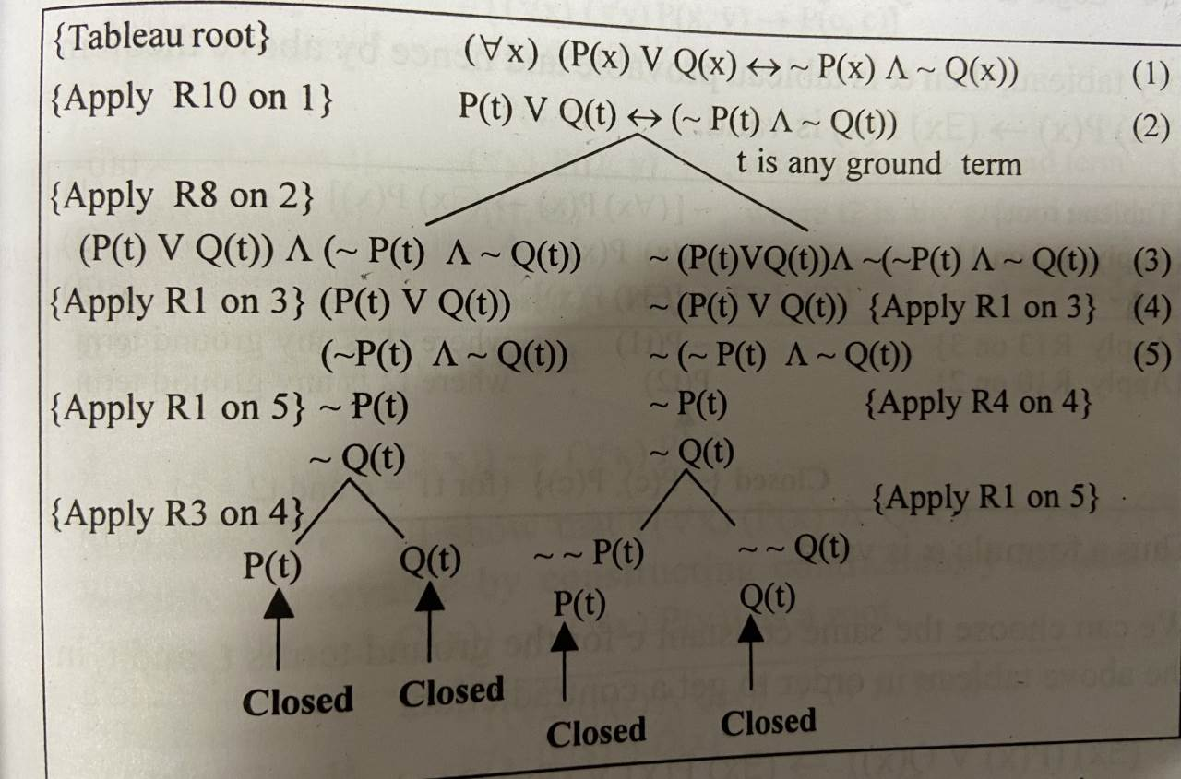
Example

Slide 55
Resolution in FOL
The resolution inference rule:
The resolution rule for first-order logic is simply a lifted version of the propositional rule.
Resolution can resolve two clauses if they contain complementary literals, which are assumed to be standardized apart so that they share no variables.

Slide 56
Resolution in FOL
We can resolve two clauses which are given below:
[Animal (g(x) V Loves (f(x), x)] and [￢Loves(a, b) V ￢Kills(a, b)]
Where two complimentary literals are: Loves (f(x), x) and ￢ Loves (a, b)
These literals can be unified with unifier θ= [a/f(x), and b/x] , and it will generate a resolvent clause:
[Animal (g(x) V ￢ Kills(f(x), x)].

Slide 57
Steps for Resolution
Conversion of facts into first-order logic.
Convert FOL statements into CNF
Negate the statement which needs to prove (proof by contradiction)
Draw resolution graph (unification).

Slide 58
Example of Resolution
John likes all kind of food.
Apple and vegetable are food
Anything anyone eats and not killed is food.
Anil eats peanuts and still alive
Harry eats everything that Anil eats.
Prove by resolution that:
John likes peanuts.

Slide 59
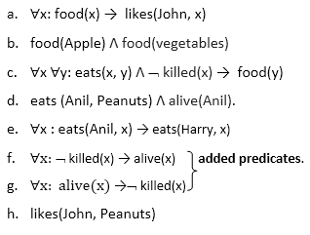
.
Step-1: Conversion of Facts into FOL
In the first step we will convert all the given statements into its first order logic.

Slide 60
Step-2: Conversion of FOL into CNF
2.1 Eliminate all implication (→) and rewrite
∀x ¬ food(x) V likes(John, x)
food(Apple) Λ food(vegetables)
∀x ∀y ¬ [eats(x, y) Λ ¬ killed(x)] V food(y)
eats (Anil, Peanuts) Λ alive(Anil)
∀x ¬ eats(Anil, x) V eats(Harry, x)
∀x¬ [¬ killed(x) ] V alive(x)
∀x ¬ alive(x) V ¬ killed(x)
likes(John, Peanuts).

Slide 61
Step-2: Conversion of FOL into CNF
2.2 Move negation (¬)inwards and rewrite
∀x ¬ food(x) V likes(John, x)
food(Apple) Λ food(vegetables)
∀x ∀y ¬ eats(x, y) V killed(x) V food(y)
eats (Anil, Peanuts) Λ alive(Anil)
∀x ¬ eats(Anil, x) V eats(Harry, x)
∀x killed(x) V alive(x)
∀x ¬ alive(x) V ¬ killed(x)
likes(John, Peanuts).

Slide 62
Step-2: Conversion of FOL into CNF
2.3 Rename variables or standardize variables
∀x ¬ food(x) V likes(John, x)
food(Apple) Λ food(vegetables)
∀y ∀z ¬ eats(y, z) V killed(y) V food(z)
eats (Anil, Peanuts) Λ alive(Anil)
∀w¬ eats(Anil, w) V eats(Harry, w)
∀g killed(g) V alive(g)
∀k ¬ alive(k) V ¬ killed(k)
likes(John, Peanuts).

Slide 63
Step-2: Conversion of FOL into CNF
2.4 Eliminate existential instantiation quantifier by elimination.
In this step, we will eliminate existential quantifier ∃, and this process is known as Skolemization.
But in this example problem since there is no existential quantifier so all the statements will remain same in this step.

Slide 64
Step-2: Conversion of FOL into CNF
2.5 Drop Universal quantifiers
¬ food(x) V likes(John, x)
food(Apple)
food(vegetables)
¬ eats(y, z) V killed(y) V food(z)
eats (Anil, Peanuts)
alive(Anil)
¬ eats(Anil, w) V eats(Harry, w)
killed(g) V alive(g)
¬ alive(k) V ¬ killed(k)
likes(John, Peanuts).

Slide 65
Step-2: Conversion of FOL into CNF
Note: Statements "food(Apple) Λ food(vegetables)" and "eats (Anil, Peanuts) Λ alive(Anil)" can be written in two separate statements.
2.6 Distribute conjunction ∧ over disjunction ¬.
This step will not make any change in this problem.

Slide 66
Step-3: Negate the statement to be proved
In this statement, we will apply negation to the conclusion statements, which will be written as ¬likes(John, Peanuts)

Slide 67
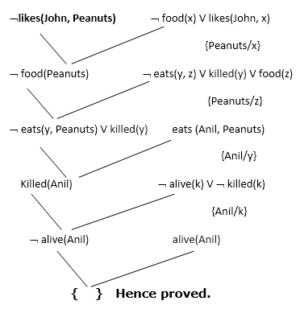
:
Step-4: Draw Resolution graph

Slide 68
Explanation of Resolution graph:
In the first step of resolution graph, ¬likes(John, Peanuts) , and likes(John, x) get resolved (cancelled) by substitution of {Peanuts/x}, and we are left with ¬ food(Peanuts)
In the second step of the resolution graph, ¬food(Peanuts) , and food(z) get resolved (cancelled) by substitution of { Peanuts/z}, and we are left with ¬ eats(y, Peanuts) V killed(y) .

Slide 69
Explanation of Resolution graph:
In the third step of the resolution graph, ¬ eats(y, Peanuts) and eats (Anil, Peanuts) get resolved by substitution {Anil/y}, and we are left with Killed(Anil) .
In the fourth step of the resolution graph, Killed(Anil) and ¬ killed(k) get resolve by substitution {Anil/k}, and we are left with ¬alive(Anil) .
In the last step of the resolution graph ¬alive(Anil) and alive(Anil) get resolved.

Slide 70
Youtube & NPTEL Video Links and Online Courses Details
Youtube Video Links
https://www.youtube.com/watch?v=6490tKrGEic
https://www.youtube.com/watch?v=wD6-My8mL-U
https://www.youtube.com/watch?v=h6sfv-qnMac
https://www.youtube.com/watch?v=RYIjxRfOPWY
https://www.youtube.com/watch?v=5araDjcBHMQ
NPTEL Courses Link
https://nptel.ac.in/courses/106105077/
Alka Singh AI Unit 03

Slide 71
Daily Quiz
Q1 There exist only two types of quantifiers, Universal Quantification and Existential Quantification.
a) True
b) False
Answer: a
Alka Singh AI Unit 03

Slide 72
Daily Quiz
Q2. First Order Logic is also known as ___________
a) First Order Predicate Calculus
b) Quantification Theory
c) Lower Order Calculus
d) All of the mentioned
Answer: d
Alka Singh AI Unit 03

Slide 73
Daily Quiz
Q3. How many proposition symbols are there in artificial intelligence?
a) 1
b) 2
c) 3
d) 4
Answer: b
Explanation: The two proposition symbols are true and false.
Alka Singh AI Unit 03

Slide 74
MCQ s
Q4. Translate the following statement into FOL.
“For every a, if a is a philosopher, then a is a scholar”
a) ∀ a philosopher(a) → scholar(a)
b) ∃ a philosopher(a) → scholar(a)
c) All of the mentioned
d) None of the mentioned
Answer: a
Alka Singh AI Unit 03

Slide 75

Alka Singh AI Unit 03

